Slide 1
Deploying Dynamic Website on AWS
SUBMITTED BY:-
Tushar Sehdev
Museib Patel
Mohd Abdul Ghani
Dhatchana Moorthy Mathan

Slide 2
INTRODUCTION
In the ever-evolving landscape of web development and cloud computing, the ability to deploy dynamic web applications with efficiency and scalability is a pivotal skill. As businesses and organizations increasingly migrate their digital infrastructure to the cloud, Amazon Web Services (AWS) has emerged as a dominant force in providing the tools and services necessary to facilitate this transformation. This project delves into the fascinating realm of "Deploying Dynamic Webpage in AWS," where we explore the integration of cloud-based solutions to host and manage dynamic web content.

Slide 3
Deploying a PHP and MySQL Website on AWS
AWS has been chosen as the cloud platform for this project due to its remarkable capabilities and features that align perfectly with the requirements of modern web hosting. Let's explore why AWS is our preferred choice.
Scalability
Reliability
Flexibility
Competitive Advantage

Slide 4
AWS Services Overview
Amazon Web Services (AWS) offers a wide range of cloud services, each designed to address specific aspects of building, deploying, and managing applications in the cloud.In this slide, we'll provide an overview of the key AWS services that we'll be using for deploying our PHP and MySQL website.
Amazon RDS (Relational Database Service):
Managed Database Service: Amazon RDS is a managed database service that simplifies the process of setting up, operating, and scaling relational databases.
Amazon EC2 (Elastic Compute Cloud):
Virtual Servers: Amazon EC2 provides resizable compute capacity in the cloud.
Security Groups:
Security Groups act as virtual firewalls for our EC2 instances and RDS databases. They allow us to define inbound and outbound traffic rules, enhancing the security of our infrastructure

Slide 5
Apache Web Server:
Apache HTTP Server, often referred to as Apache, is an open-source web server software widely used for serving web content and executing PHP scripts.
Amazon VPC (Virtual Private Cloud):
Amazon VPC allows us to create isolated network environments within AWS.
AMAZON RDS:
It is a managed database service offered by AWS.It’s benefits:-
Scalability
High Availability

Slide 6
DEPLOYMENT STEPS
Step 1: Set up Amazon RDS for MySQL
Step 2: Launch Amazon EC2 Instances
Step 3: Configure Security Groups
Step 4: Install and Configure Apache Web Server
Step 5: Connect Web Servers to RDS Database

Slide 7
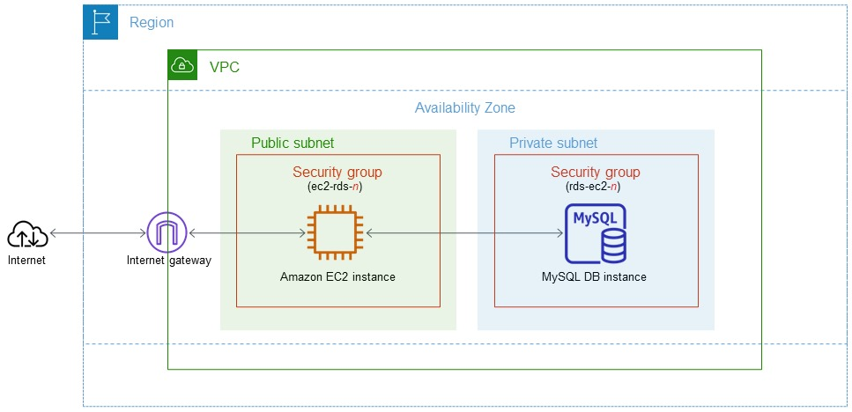
Architectural Diagram

Slide 8
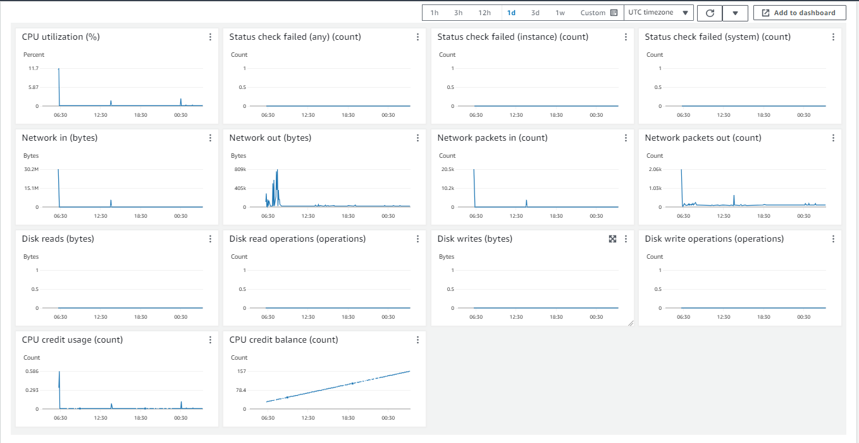
Performance Analysis

Slide 9
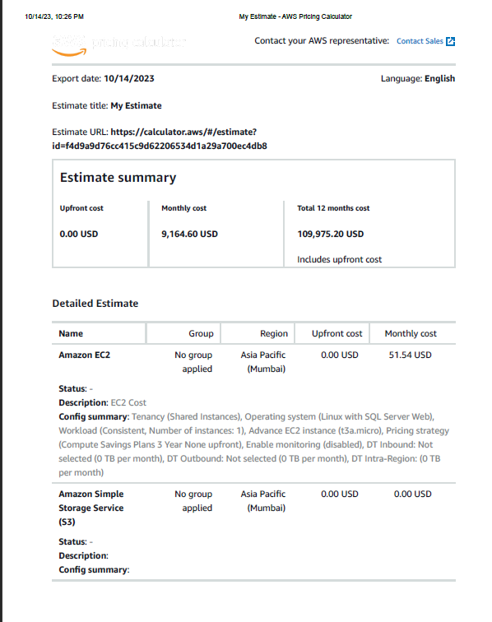
COST ANALYSIS

Slide 10
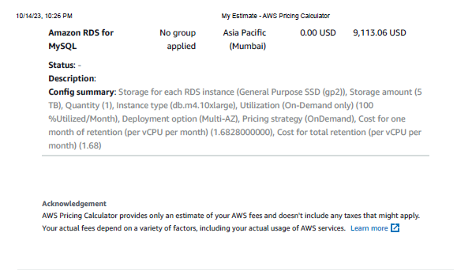

Slide 11
Advanced topics of SQL database
1. SQL Databases in AWS: AWS offers various managed SQL database services, including Amazon RDS (Relational Database Service), Amazon Aurora, and Amazon Redshift.
2. Database Replication:Replication is the process of copying data from one database to another. In the context of AWS, you can set up replication in several ways:-
Amazon RDS Multi-AZ
Read Replicas
Aurora Global Database
3. Distributed Architecture

Slide 12
4. High Availability : High availability ensures that your database remains accessible and operational even in the face of failures.
5. Disaster Recovery Strategies in AWS: Disaster recovery is critical for minimizing downtime and data loss in the event of catastrophic failures or disasters.
Backup and Restore
Multi-Region Replication
6. Data Encryption and Security:
Encryption: Use SSL/TLS for data in transit and AWS Key Management Service (KMS) for data at rest encryption.
Security Groups and Network ACLs: Implement proper network security controls to restrict access to your database instances.
7. Monitoring and Alerts: Utilize AWS CloudWatch and database-specific metrics to monitor the health and performance of your databases.
8. Scaling Strategies: Implement auto-scaling and capacity planning to handle changing workloads effectively.

Slide 13
Comparative analysis of SQL with other databases.
1. SQL Databases:
Strengths:
Structured Data
Mature Query Language
Weaknesses:
Scalability
Performance

Slide 14
2. NoSQL Databases
Strengths:
Scalability
Flexibility
Weaknesses:
Limited Query Capabilities
4. Graph Databases
Strengths:
Relationship Modeling
Performance for Connected Data
Weaknesses:
Scalability
Data Complexity

Slide 15
Conclusion
In conclusion, managing SQL databases within the AWS ecosystem is a critical component of modern database management. AWS provides a versatile array of services, including Amazon RDS, Aurora, and Redshift, catering to diverse database engines and use cases. This report has thoroughly examined database replication, distributed architecture, high availability, disaster recovery, security, monitoring, scaling, and compliance considerations, creating a robust environment for SQL databases on AWS.
Moreover, we conducted a comparative analysis of SQL databases with other database types, helping organizations make informed decisions based on their specific needs. AWS empowers businesses to deploy, manage, and secure SQL databases with flexibility, scalability, and an extensive feature set. Understanding these intricacies is essential in the ever-evolving data management landscape, ensuring data integrity, availability, and security. The adoption of best practices and security measures lays a strong foundation for organizations to harness the potential of SQL databases in AWS.

